Slide 1

Automotive Technology: A Systems Approach, 8e
Chapter 55: Air-Conditioning
Diagnosis and Service
Rob Thompson and Jack Erjavec, Automotive Technology: A Systems Approach, 8th Edition. © 2025 Cengage. All Rights Reserved. May not be scanned, copied or duplicated, or posted to a publicly accessible website, in whole or in part.

Slide 2
Chapter Objectives (1 of 3)
55.01 Explain the service precautions for working on the A/C system.
55.02 Understand the special handling procedures for automotive refrigerants.
55.03 Determine the refrigerant type, test refrigerant type, and check for sealants.
55.04 Describe how to connect a manifold gauge set and a recovery/recycling machine to a system.

Slide 3
Chapter Objectives (2 of 3)
55.05 Perform a performance test on an A/C system.
55.06 Describe methods used to check refrigerant leaks.
55.07 Use approved methods and equipment to discharge, reclaim/recycle, evacuate, and recharge an automotive A/C system.

Slide 4
Chapter Objectives (3 of 3)
55.08 Interpret pressure readings as an aid to diagnose A/C problems.
55.09 Service components of the A/C system.
55.10 Diagnose and repair A/C control systems.

Slide 5
Service Precautions
55.01 Explain the service precautions for working on the A/C system.
Wipe away any oil or dirt before disconnecting a connection.
Keep tools clean and dry.
Refrigerant oil containers must be clean and dry.
Leave a system open for the shortest time possible.
Evacuate a system any time it has been opened.

Slide 6
Refrigerant Safety Precautions (1 of 3)
55.02 Understand the special handling procedures for automotive refrigerants.
Work in a well-ventilated area.
Refrigerant will cause frostbite if it contacts exposed skin or eyes.
Wear protective gloves and clothing in addition to eye protection.
Never use compressed air to leak test a R-134a system.

Slide 7
Refrigerant Safety Precautions (2 of 3)
Never drop, strike, puncture, or burn a refrigerant container.
Never expose A/C systems or refrigerants to high temperatures or open flame.
Never overfill refrigerant containers.
Never mix R-12 and R-134a, components, or equipment.

Slide 8
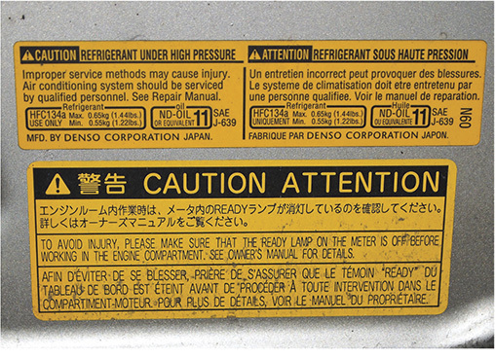
Refrigerant Safety Precautions (3 of 3)
Pay attention to all warning and service decals.

Slide 9
Special Precautions for Hybrid Vehicles (1 of 2)
All high-voltage wires and harnesses are wrapped in yellow- or orange-colored insulation.
Respect the color and stay away from it unless the system is depowered.
Do not attempt to service these cables and parts without the correct protective gear and service information.

Slide 10
Special Precautions for Hybrid Vehicles (2 of 2)
Always use insulated tools.
Remove anything metallic, such as rings, necklaces, watches, and earrings, when working on a hybrid or electric vehicle.

Slide 11
Initial System Checks (1 of 2)
Verify the complaint.
Check operation at full heat and full cold.
Pay attention to smells and noises.
Inspect the compressor drive belt.
Look for a film of oil leakage.
Check for condenser airflow restrictions.

Slide 12
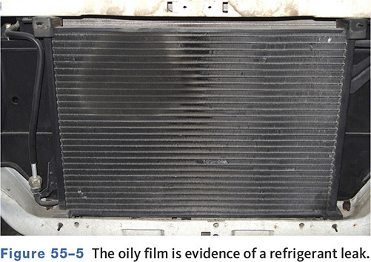
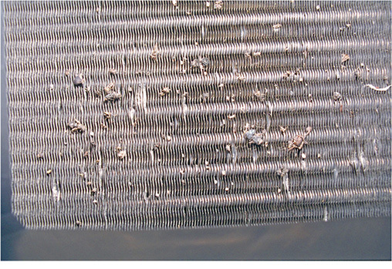
Initial System Checks (2 of 2)
  Oil is a sign of a leak.
Check condenser for damage and debris.

Slide 13
Simple Checks
Vent outlet temperatures.
Check Blower speeds.
Feel for temperature differences of high and low side hoses.
Expansion valve should be frost free.
Check the sight glass if equipped.

Slide 14
Trouble Codes
Late-model A/C systems have a self-diagnostic capability.
On most modern vehicles, part of the A/C system can be checked with a scan tool connected to the vehicle’s BCM.

Slide 15
Diagnosis
Noise
  Clutch noises
  Hose noises
  Compressor noise
  Hissing and whistling
Odors
      Moldy or musty smells
      Cabin air filters

Slide 16
Performance Testing
55.04 Describe how to connect a manifold gauge set and a recovery/recycling machine to a system.
Connect a manifold gauge set.
Use temperature/pressure charts as a guide.
Monitor discharge temperatures with a thermometer.
When unsure of the refrigerant, run a purity test.

Slide 17
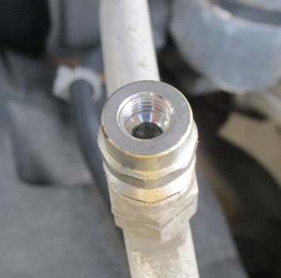
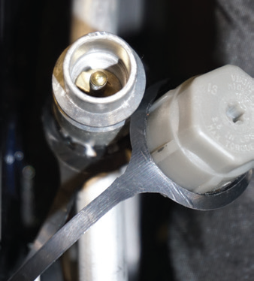
Service Valves
R-134a System
R-1234yf System

Slide 18
Purity Test
55.03 Determine the refrigerant type, test refrigerant type, and check for sealants.
Performed when the contents of the system are unknown
A refrigerant identifier is used to sample contents.
It is recommended that the system be tested for sealant identification and/or contamination before conducting the purity test.
A purity test can prevent damage to equipment in the event combustible agents are present.

Slide 19
Manifold Pressure Gauge
Used when discharging, charging, evacuating, and diagnosing the system

Slide 20
Connecting the Gauge Set
55.04 Describe how to connect a manifold gauge set and a recovery/recycling machine to a system.
Locate the high- and low-side service valves.
Make sure the gauge set valves are closed.
Purge each gauge set hose to remove air trapped in the hoses and gauges.

Slide 21
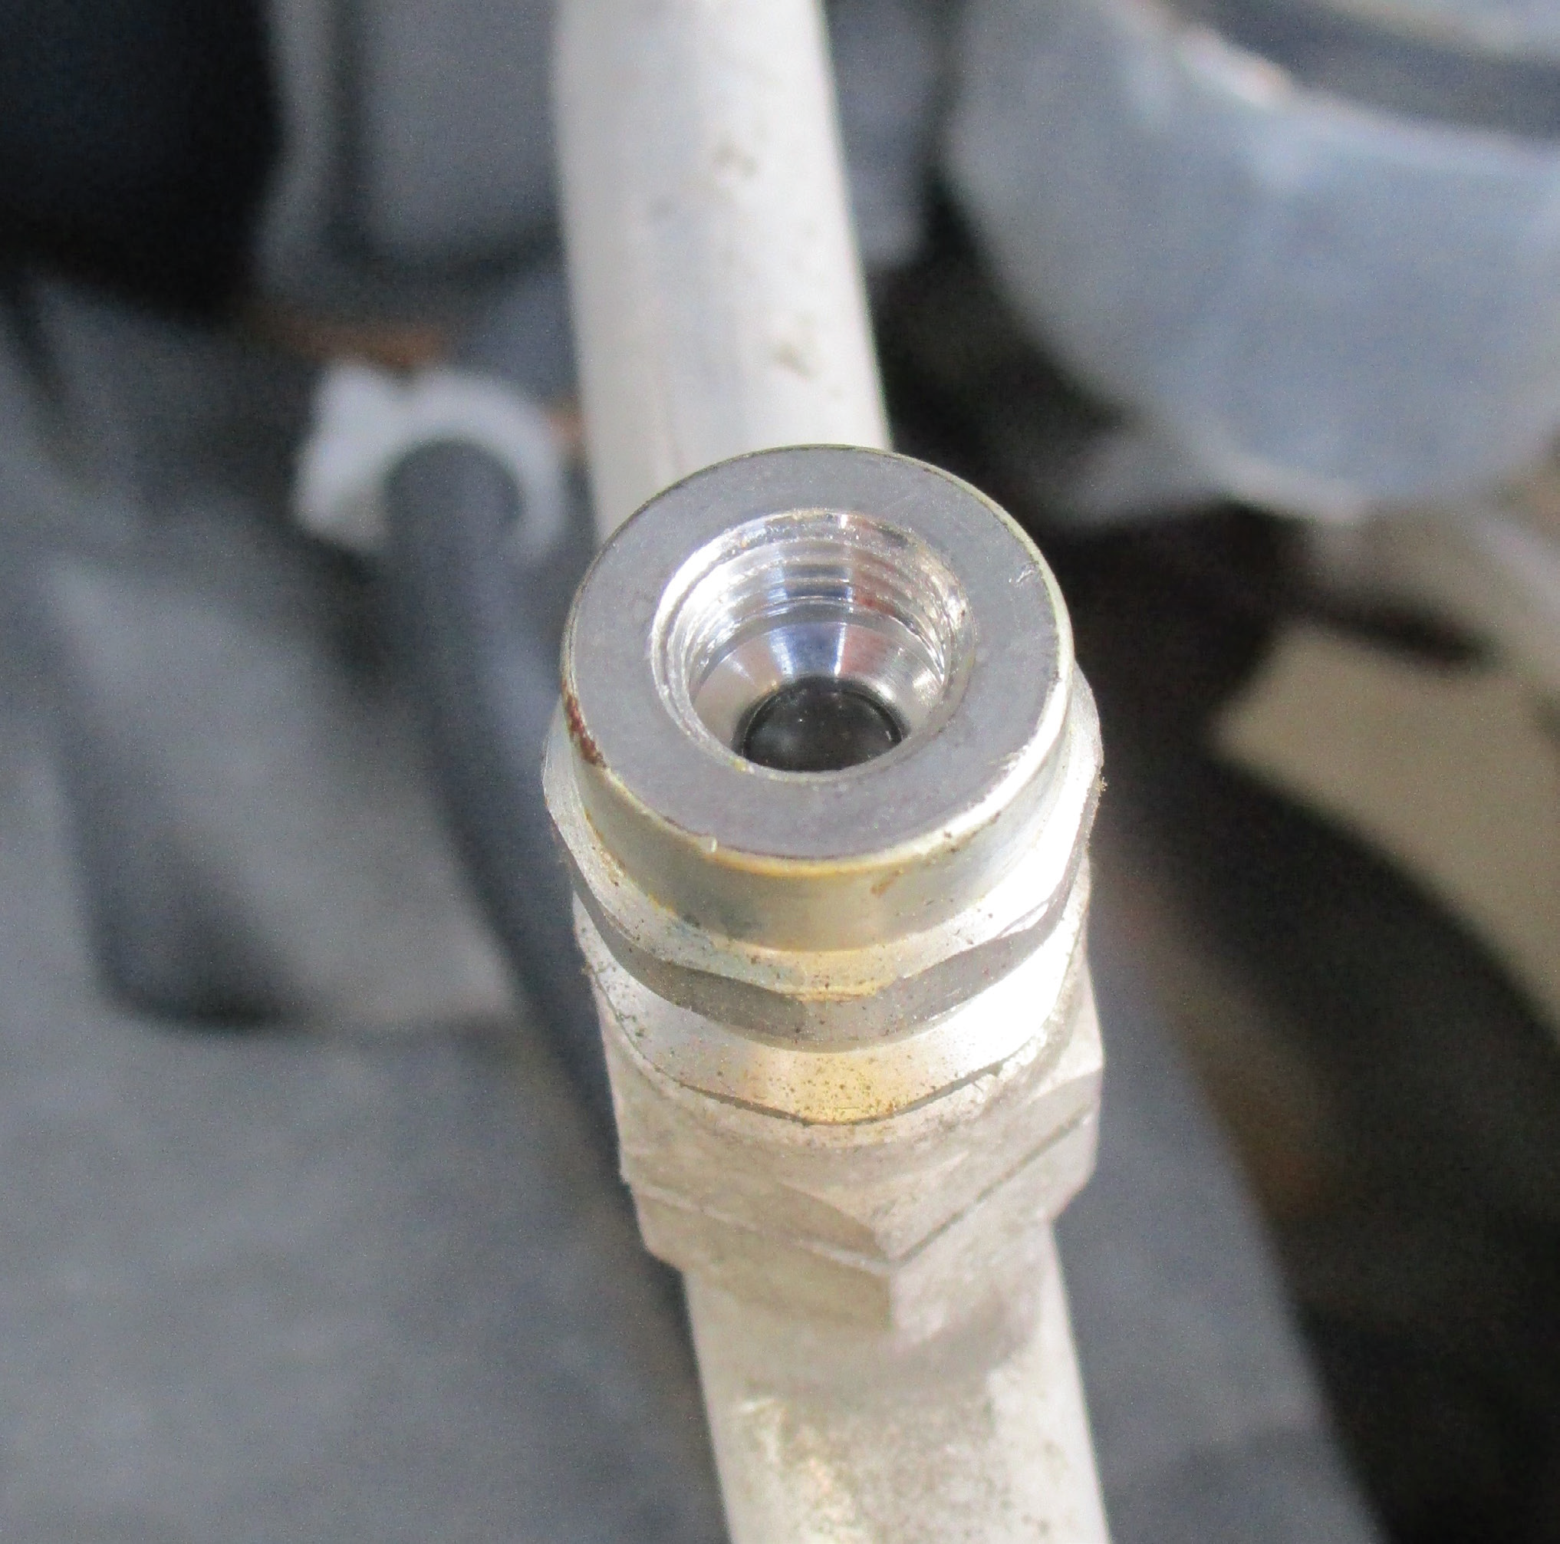
Schrader Valves
R-134a Valve
R-1234yf Valve

Slide 22
Testing Procedures
55.08 Interpret pressure readings as an aid to diagnose A/C problems.
Run engine between 1500 and 2000 rpm.
Close all vehicle windows and doors.
Set A/C to maximum cooling.
Check gauge pressures and outlet temperature.
Refer to the manufacturers temperature and pressure charts.

Slide 23
Performance Test Readings (1 of 2)
High-side pressure is higher than normal.
  Air in the system
  Restriction on the high-side
  Poor airflow across the condenser
High-side pressure is lower than normal.
  Low refrigerant
  Defective compressor

Slide 24
Performance Test Readings (2 of 2)
Low-side pressure is higher than normal.
  Refrigerant overcharge
  Faulty metering device
  Defective compressor
Low-side pressure is lower than normal.
    Faulty metering device
    Poor airflow across the evaporator
    Restriction in the low side
    Refrigerant undercharge

Slide 25
Knowledge Check (1 of 2)
A HVAC system does not cool and has low low-side and low high-side pressures.
Technician A says the system in undercharged.
Technician B says the condenser is probably blocked.
Who is correct?

Slide 26
Knowledge Check Answer (1 of 2)
A HVAC system does not cool and has low low-side and low high-side pressures.
Technician A says the system in undercharged.
Technician B says the condenser is probably blocked.
Who is correct?
Answer: Technician A only

Slide 27
Leak Testing
55.06 Describe methods used to check refrigerant leaks.
Leaks often cause low-pressure readings.
Perform a visual inspection
Leaks are most often found at the compressor hose connections and at the various fittings and joints in the system.
Most manufacturers do not recommend stop leak products.

Slide 28
Leak Detector Types
  Electronic leak detector
  Fluorescent (UV) leak tracer
  Fluid leak detector

Slide 29
Electronic Leak Detector

Slide 30
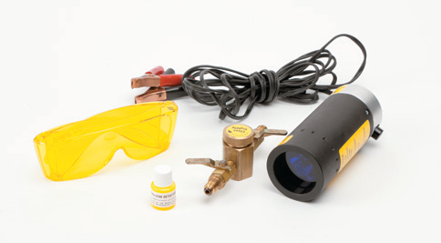
Fluorescent Dye Leak Detection
A special dye is added to the system.
After the system has run, check for leaks using a UV light.

Slide 31
Emptying the System
55.07 Use approved methods and equipment to discharge, reclaim/recycle, evacuate, and recharge an automotive A/C system.
Identify the refrigerant.
Never mix types of refrigerant.
Follow the equipment manufacturer’s procedures.
Refrigerants that are less than 98 percent pure will fail the tests and should not be recycled.

Slide 32
Recycling
All recycled refrigerant must be safely stored in DOT CFR Title 49 or UL-approved containers.
Before reuse, the refrigerant must be checked for noncondensable gases.
Must meet SAE standards for proper system performance.
Periodic equipment maintenance (such as filter changes) is necessary.

Slide 33
General Service
All refrigerant must be recovered.
Component replacement may require the addition of refrigerant oil to system.
Always use the specific type and quantity oil required.
Too much oil reduces cooling capacity.
Too little oil results in poor lubrication.

Slide 34
Refrigerant Oil
Normally, oil is mixed in with the refrigerant.
Install the correct amount and type of oil.
Mixing different types of oils can lead to deterioration of system components and failure.
If there is a surplus of oil in the system, too much will circulate with the refrigerant causing the cooling capacity of the system to be reduced.

Slide 35
Clutch Service
Inspect for discoloration, peeling, or other damage.
Check pulley drag and play.
Measure clutch coil resistance.
Inspect clutch clearance with a feeler gauge.
Some clutches can be replaced on the vehicle.

Slide 36
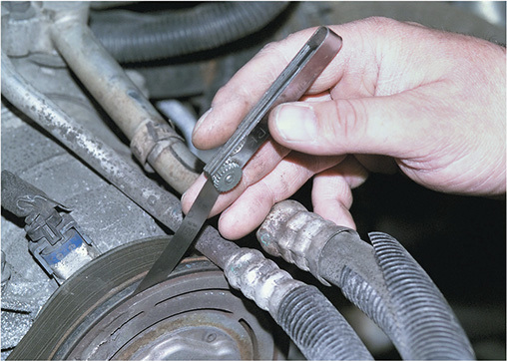
Checking Clutch Clearance

Slide 37
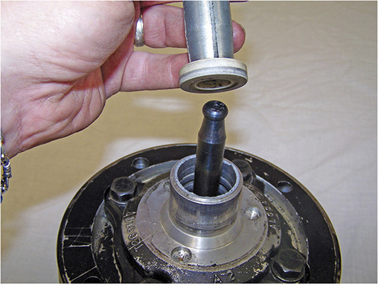
Compressor Service
Compressors are typically replaced instead of rebuilt.
Shaft seals may be replaced.

Slide 38
System Flushing
Compressor failure causes foreign material to pass into the system.
Flush the condenser and lines
Replace the accumulator/dryer
Use only the flushing agent specified by the manufacturer

Slide 39
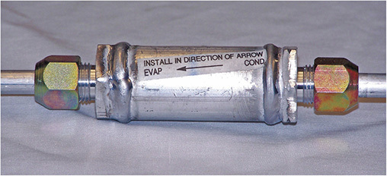
In-Line Filters
Most effective way to trap debris
Install whenever a compressor has seized or had severe damage
Filters without orifices should be installed in the liquid line between the condenser and evaporator.

Slide 40
Knowledge Check (2 of 2)
Technician A says compressor oil should be checked and filled each time the system is charged.
Technician B says compressor oil is added with the refrigerant charge. Who is correct?

Slide 41
Knowledge Check Answer (2 of 2)
Technician A says compressor oil should be checked and filled each time the system is charged.
Technician B says compressor oil is added with the refrigerant charge. Who is correct?
Answer: Technician B only

Slide 42
Compressor Controls
Check various control switches for resistance or continuity
    Ambient temperature switch
    Thermostatic switch
    Pressure cycling switch
    Low-pressure cutoff switch
    Electronic cycling control switch
    High-pressure cutoff switch
    Evaporator temperature sensor

Slide 43
Hoses and Fittings
55.09 Service components of the A/C system.
Total hose replacement is the preferred method to correct a hose leak.
Using insert barb fittings and a length of replacement hose, an acceptable replacement can be fabricated.
Inspect fittings.
Spring lock fittings require special tools.
Lubricate new O-rings with refrigerant oil.

Slide 44
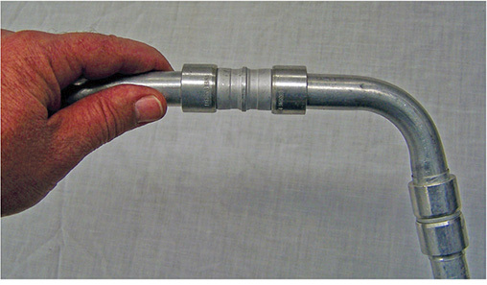
Line Repairs
Repairs to rigid lines can be made with special collars.

Slide 45
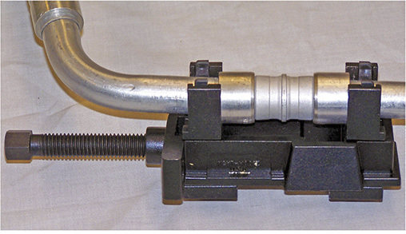
Line Repairs
A designated tool is used to press the collar into the tube.

Slide 46
Receiver/Dryer and Accumulator
Should be changed when there has been a leak and/or component replacement
The desiccant rapidly draws moisture and can be contaminated in less than 5 minutes.
Keep the new unit sealed until ready to install.

Slide 47
Evaporator
Some can be replaced from under the hood or under the dash.
Many require dash removal to replace.
Inspect the evaporator drain.
    Inadequate or no draining will allow water to back up into the evaporator case.
    Can cause wet floorboards and mildew smells

Slide 48
Odor Control
Make sure the evaporator drain is clear
  A plugged drain can cause mildew and odor.
To reduce odors, manufacturers and the aftermarket supply disinfecting kits to clean the evaporator.

Slide 49
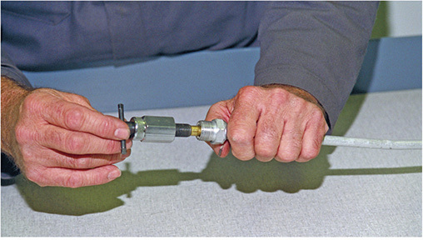
Expansion Devices
Many newer models use orifice tubes.
To replace, always use the tools recommended by the manufacturer.
Coat the new tube with clean refrigerant oil

Slide 50
Condenser
Normally, only needs replaced if leaking or damaged
Once removed, drain oil into a graduated container
Add the necessary amount of new oil to the new condenser
Coat the O-rings with new oil

Slide 51
Recharging the System
All of the refrigerant in the system must be recovered prior to evacuation.
Evacuate the system to remove all trapped air and moisture
The vacuum pump should remain connected for at least 30 minutes after 29 inches of mercury is reached.

Slide 52
Charging
Refrigerant is added through the service ports.
Charge only through the low side when the system is operating
Some vehicles charge through the high side with the system off.
Currently, the only approved way to charge R-1234yf systems is by a Section 609 certified technician using a R-1234yf RRR unit.

Slide 53
Charging Cylinder (1 of 2)
To accurately measure charging by cylinder weight, it is necessary to compensate for variations caused by temperature.
A calibrated chart is used based on tank pressure.

Slide 54
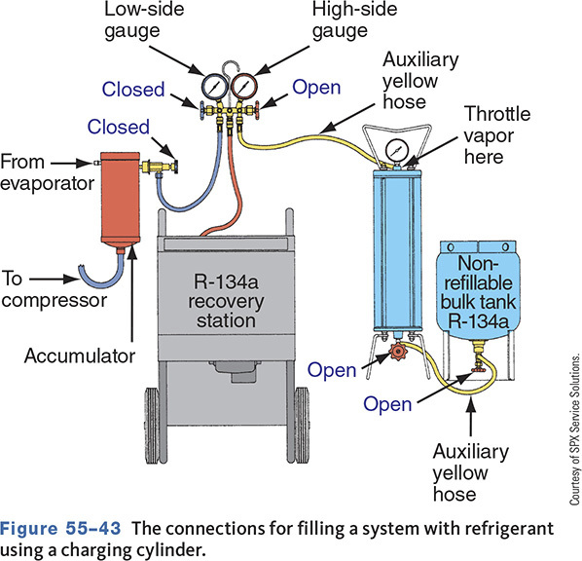
Charging Cylinder (2 of 2)

Slide 55
Testing for Noncondensable Gases
Install a calibrated pressure gauge on tank.
Measure pressure in the tank.
Measure ambient temperature.
Compare the temperature/pressure.
If noncondensable gases are present, recycle the refrigerant again.

Slide 56
Recovery/Recycling/Recharging Station Maintenance
Most systems have replaceable filters that need to be changed after a certain amount of refrigerant filtration.
If the machine has a refrigerant identifier, there is likely a separate filter, oxygen sensor, and sample hose that needs to be replaced.
To keep the vacuum pump operating correctly, the pump oil should be changed after a certain number of hours of use.

Slide 57
Climate Control Systems
55.10 Diagnose and repair A/C control systems.
Most systems have self-diagnostics.
Inspect blower motor operation.
Check operation of controls, doors, and ducts.
Solar sensor operation may be checked through scan data.

Slide 58
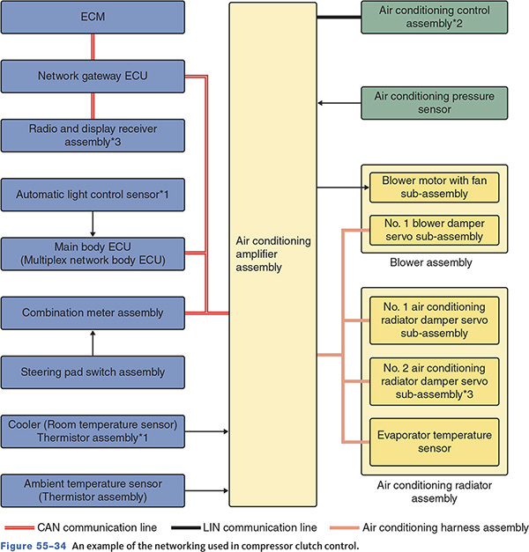
Networking
Notes:
Explain the operation of a network.

Slide 59
Self-Diagnostics
Capabilities will vary from car to car.
If the unit is part of the PCM/BCM system, connect the scan tool and retrieve any codes that may be present.
Check the service information for the proper procedures.

Slide 60
Solar Sensor
The solar sensor detects sunlight.
The output voltage from the sensor varies with the amount of sunlight.
The sensor is monitored by the A/C control module.
Trouble codes will set when a problem is detected.

Slide 61
Chapter Reflection
Write down a concept from this chapter that challenged you. Describe what made the concept difficult for you. What steps did you take improve your understanding? How could you help another learner who was struggling with the same concept?
Use 100–150 words in your answer.

